Slide 1
Data compression Neural Network Image Compression (NPEG)
授課老師:高立人 教授 In the feature!!

Slide 2
目錄

Slide 3
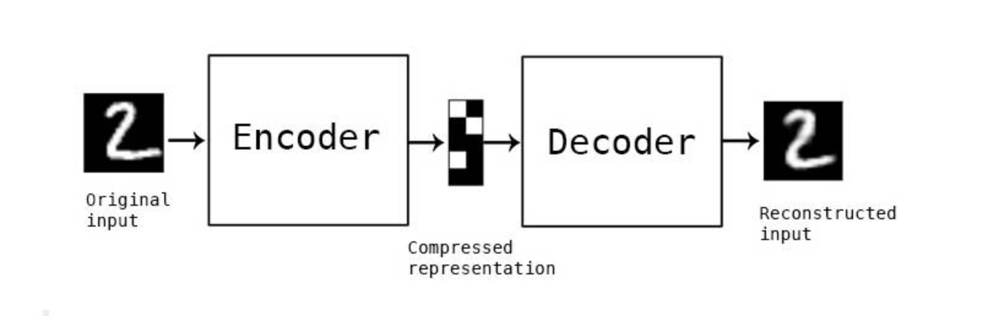
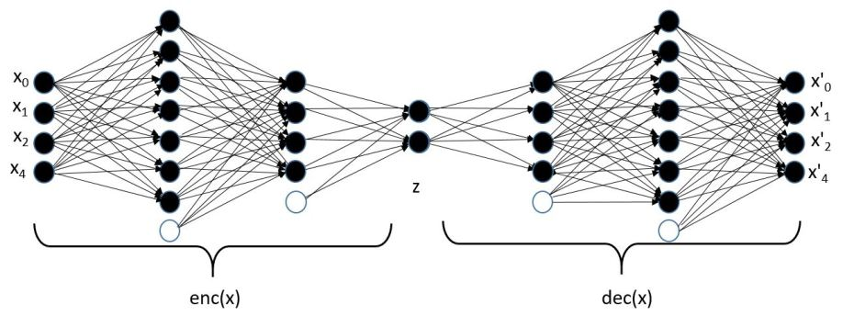
Neural Network Image Compression(NNIC)架構 Autoencoder

Slide 4
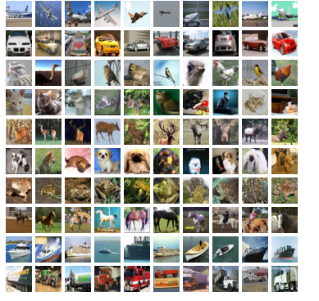
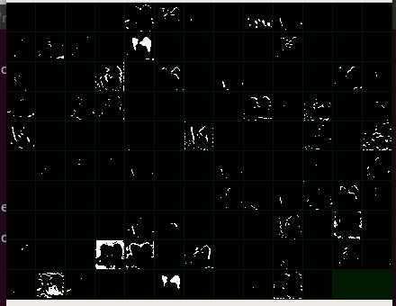
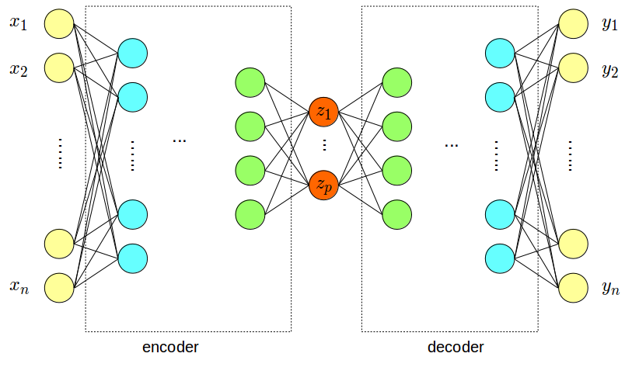
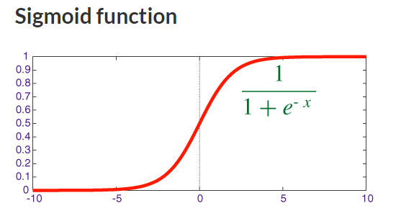
Process
image -> Encoder CNN -> features
features -> sigmoid -> binary quantization -> code
code -> Decoder CNN -> reconstruction
[0,1,0,0,0,….,0] ,total 128 bits
0.5

Slide 5
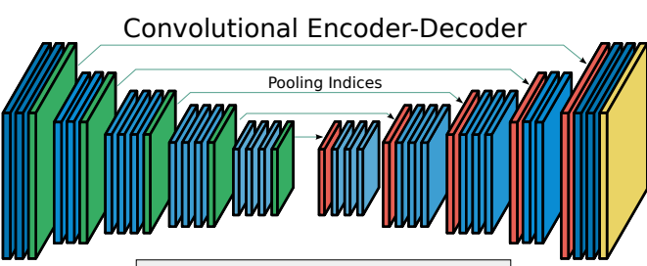
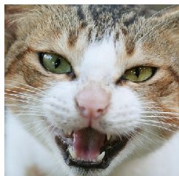
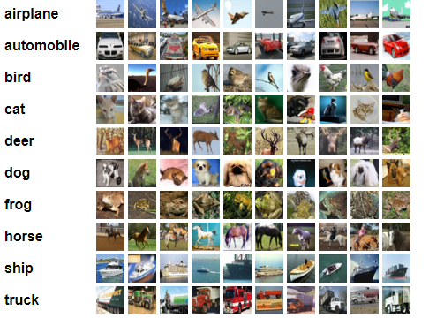
訓練架構
Input image
reconstruct Image
The CIFAR-10 dataset
VGG16
60000 32x32 colour images in 10 classes

Slide 6
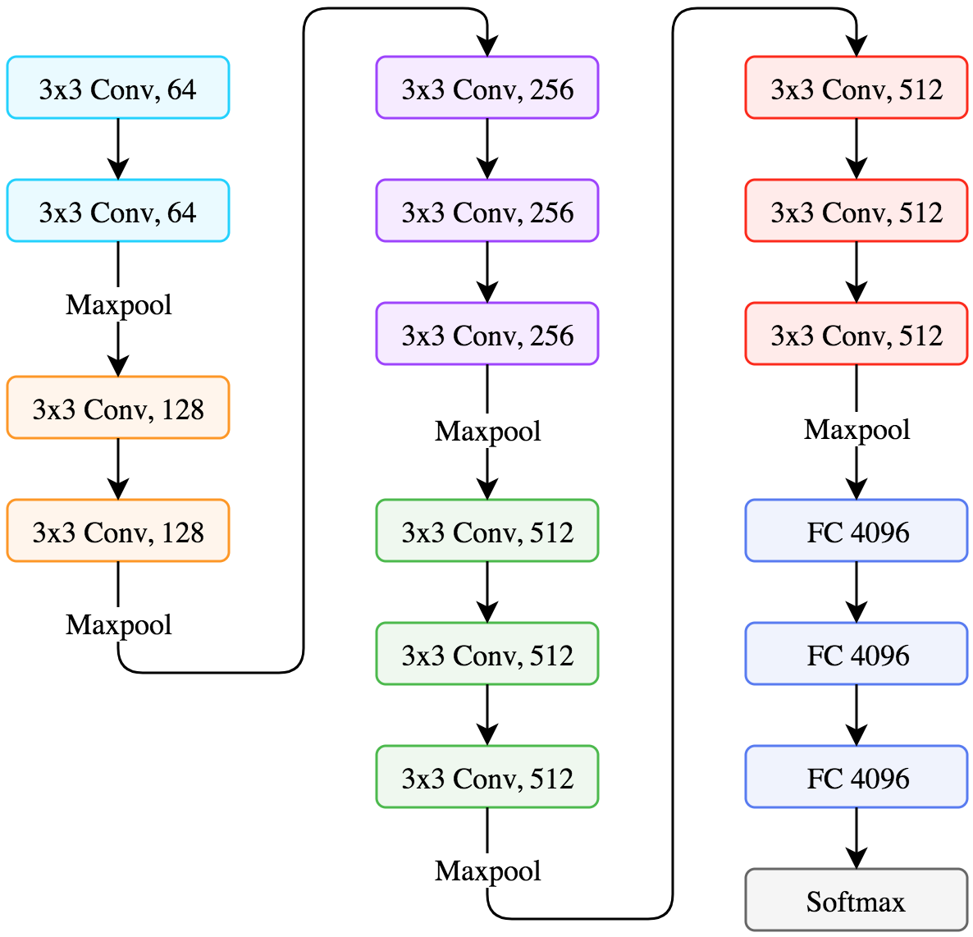
VGG16
Sigmoid Function
32x32 colour Images
binary quantization -> code
[0,1,0,0,0,….,0] ,total 128 bits

Slide 7
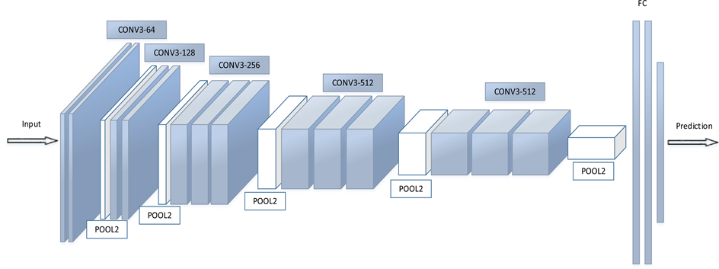

Slide 8
Own Architecture
0.5
Sigmoid Function
Conv3-16
Conv16-32
Conv32-64
Conv64-128
binary quantization -> code
[0,1,0,0,0,….,0] ,total 128 bits

Slide 9
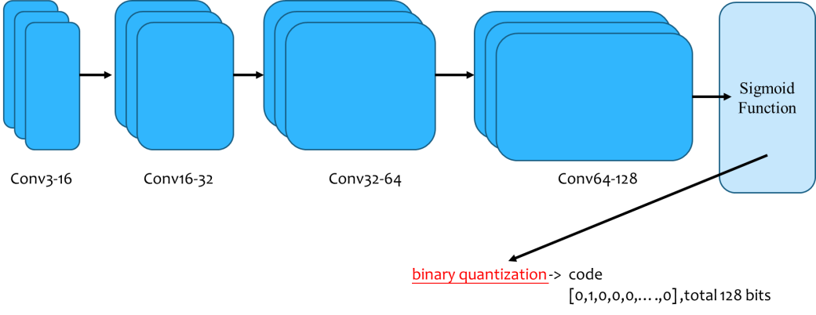
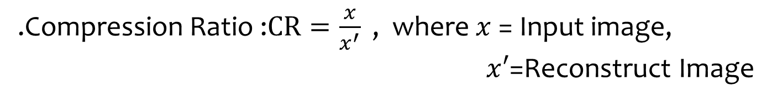
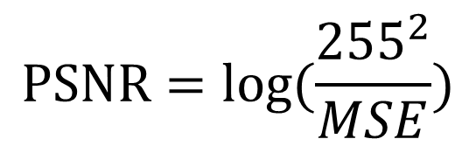
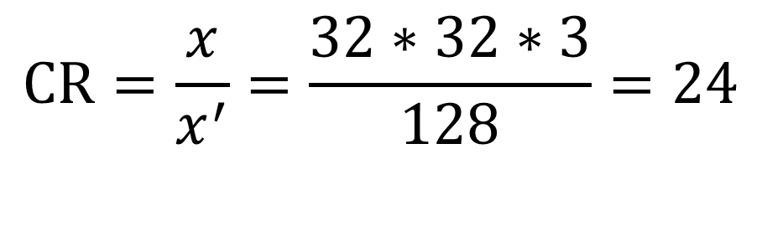
實驗結果
.Compression Ratio :$CR=\frac{x}{x^{′}}$ , where $x$= Input image,
$x﷮′$=Reconstruct Image
$$CR=\frac{x}{x^{′}}=\frac{32∗32∗3}{128}=24$$
2.Image Quality we can compute the Mean Square Error(MSE) to
represent the image quality.
$$PSNR=log(\frac{{255}^{2}}{MSE})$$
Let see the demo….!!!!

Slide 10
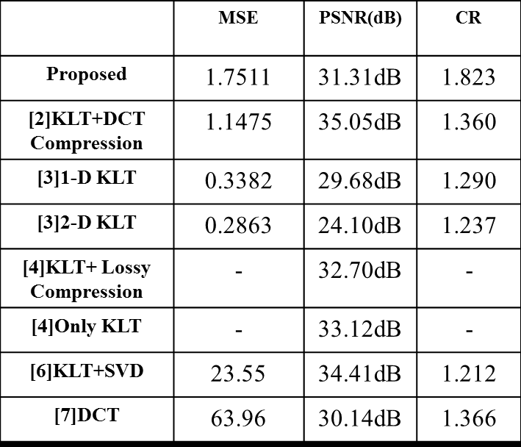
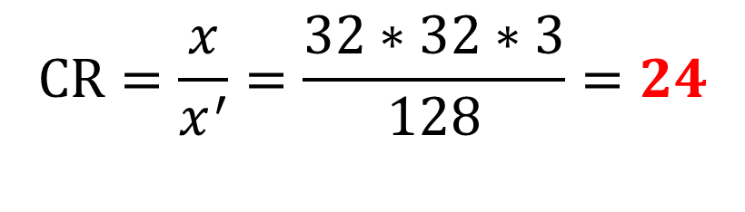
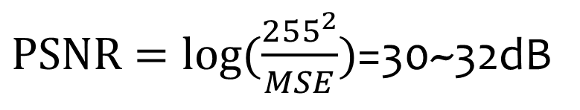
[9]1D-PCA
$$CR=\frac{x}{x^{′}}=\frac{32∗32∗3}{128}=24$$
$PSNR=log(\frac{{255}^{2}}{MSE})$=30~32dB
As we will see in the experiment that a good trade off between the computation complexity

Slide 11
參考資料
[1] Qian Du and James E. Fowler ”Hyperspectral Image Compression Using JPEG2000 and Principal Component Analysis”,IEEE GRSL. Intell., vol. 4,April 2007 . pp. 201-205.
[2] Pun-Mo Ho,Tien-Tsin Wong, Chi Sing Leung and Chi Sing Leung ”PCA-Baesd Compression for Image-Based Relightinh”,IEEE ICME. 2003, pp. 473-474
[3] Mohammad Mofarreh-Bonab ”A New Technique for Image Compression
Using PCA”, International Journal of Computer Science and Communication Networks . 2012, vol. 2, pp. 111-116
[4] Pengwei Hao and Qingyun Shi, ”Reversible Integer KLT For Progressive-to-Lossless Compression Of Mulipe Component Images”(ICIP), Nov. 2003, pp. 14-17
[5] Shutao Li, James T. Kwok, and Yaonan Wang, ”Using the discrete wavelet frame transform to merge Landsat TM and SPOT panchromaticimages” ELSEVIER, June. 2002, pp. 17-23
[6] Patrick Waldemar and Tor A. Ramstad ”Hybrid KLT-SVD Image Compression”,IEEE ICASSP, August,2002 pp.21-24
[7] Yung-Gi Wu and Shen-Ghuan Tai ”Low Bit Rate Subband DCT ImageCompression”,IEEE ICCE vol. 43,no 2,MAY,1997 pp.134-144
[8] Giridhar Mandyam, Nasir Ahmed and Neeraj Magotra,”Lossless ImageCompression Using the Discrete Cosine Transform” ,Journal of VisualCommunication and Image Represntation Vol. 8, No. 1, March,1997 pp.21-26
[9] You-Ran Liu, and Lih-Jen Kau ,Scalable Face Image Compression Based on Principal Component Analysis and Arithmetic Coding, 2017 IEEE International Conference on Consumer Electronics,pp.265-266

